Slide 1
Don't be scared of calling APIs!
Graziella Iezzi
Notes:
[REQUIRED SLIDE]

Slide 2
How to insert your Twitter handle
1. On the Insert tab, select Header & Footer.
2. On the Slide tab, check the Footer box.
3. In the box below Footer, type your Twitter handle (e.g. @PSConfEU).
4. To prevent the footer from appearing on the title slide, check the Don't show on title slide box.
5. Click Apply to All button.

Slide 3
Notes:
[REQUIRED SLIDE]

Slide 4
Agenda
What is an API
Invoke-RestMethod, Invoke-WebRequest
Authentication
Pagination
Examples about how to get and send data
Summary

Slide 5
What’s an API?
Application Programming Interface
“a set of endpoints that allows you
to interact with a specific web application”
Endpoints are web-based (HTTP and HTTPS) functions. The interaction is mostly possible through JSON or XML

Slide 6
APIs different standards
REST - Representational State Transfer
The architectural style that defines the constraints about how the API can be developed
SCIM - System for Cross-domain Identity Management
Implements the identity management (i.e. users and groups) defined in the REST definition providing a schema and an HTTP-based protocol
Graph API
Models the data in terms of nodes and edges, where the edges represent the relationship between nodes
Open API
Defines a standard, programming language-agnostic interface description for REST APIs

Slide 7
What to know before calling an API
Authentication: which kind is used
Methods ( GET, POST, PUT, PATCH, DELETE, etc): what action do you need to do
Headers: what additional information (Content-Type, Authentication, etc) do you need to pass to the endpoint
Body: what data do you need to send to the endpoint, and what’s the expected format

Slide 8
PowerShell Cmdlets
Invoke-WebRequest
“Gets content from a web page on the internet”
Invoke-RestMethod
“Sends an HTTP or HTTPS request to a RESTful web service”
Both can send an HTTP/HTTPS requests to a web page or web service
Both have a set of similar parameters

Slide 9
Where are they different?
“they parse the data before presenting the response differently”
Invoke-WebRequest
Returns data in an HTML format
Output is Microsoft.PowerShell.Commands.BasicHtmlWebResponseObject
Invoke-RestMethod
Sends requests to REST web services that return richly
structured data (i.e. JSON, XML)
Output is System.Int64, System.String, System.Xml.XmlDocument

Slide 10
Use cases
Authentication (Jira, BlueJeans, Slack, Trello)
Pagination (Slack, Workplace, GitHub)
Get data - why and what to do with it (Workplace)
User deprovisioning (Trello)
Grant user permissions (BlueJeans)

Slide 11
Authentication
Basic authentication
username and password
encoded in base64
Bearer Token:
a string representing an access authorization issued to the client
TLS is mandatory
if generated programmatically they are returned in a JSON format
can be send in the header, the body or in query string

Slide 12
Pagination
“it is the concept of dividing the results into different pages”
Some types of pagination:
none
Offset / Seek / Keyset
Cursor / Relay Cursor
Relation link in the response header

Slide 13

Use Case: Workplace
“Can you give me the list of the members in this group?”
“... only the ones that joined in the last week?”
“... can you add the department they are from?”
“... can you send it to me by email every week?”
Is there an endpoint for it?
How do I use dates in PowerShell?
How do I send an email in PowerShell?... with an attachment

Slide 14
Use Case: Trello
Emails not exposed in the API (not even in the interface)
Deprovision couldn’t be fully automated
… also, with time you improve your knowledge, so update your scripts!

Slide 15
Use case: BlueJeans
Setting up additional permissions for users
Most of the times you need to get the real user identifier before you can run the update

Slide 16
Summary
APIs are an amazing tool, but you need to understand how they work
PowerShell provides you with amazing cmdlets, but you still need to pay attention to the data
Keep your tokens safe!

Slide 17
Notes:
[REQUIRED SLIDE]

Slide 18
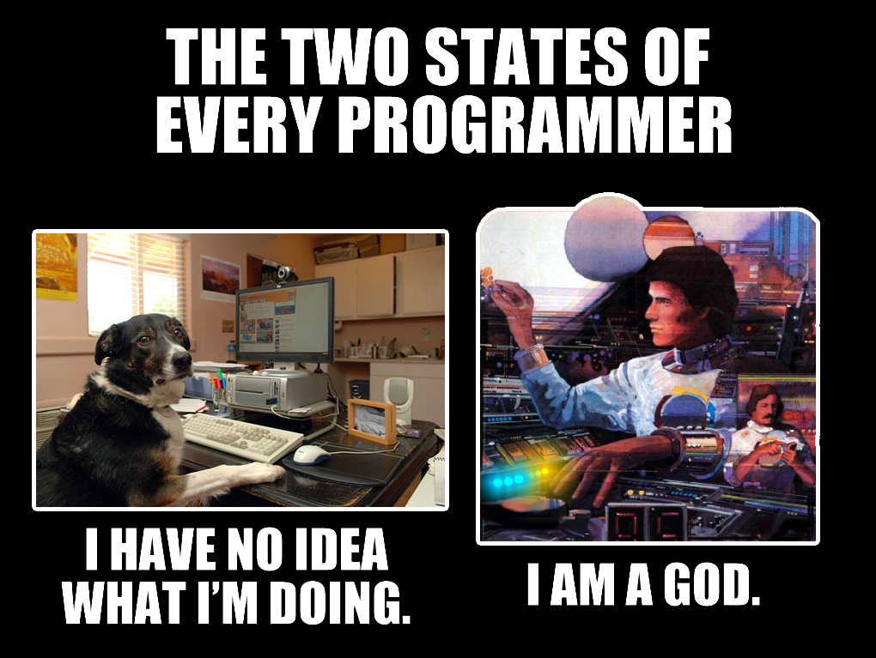
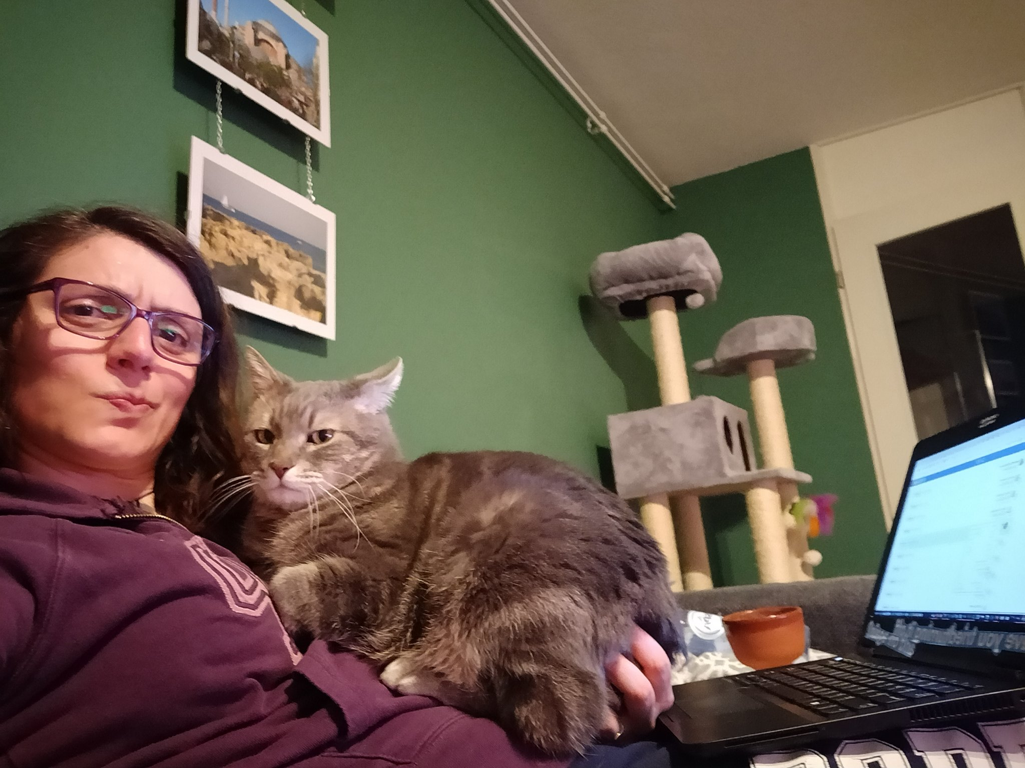
about_Speaker
IT Business Applications Engineer @ Booking.com
PowerShell amateur
I feel seen by this meme
Sometimes I have to accept my faith and
just work like this!
Notes:
[REQUIRED SLIDE]

Slide 19

Delegate sign-up opens November 2020 at https://psconf.eu
Notes:
[REQUIRED SLIDE]

